Slide 1
Python – Data Types
Premanand S

Slide 2
Data types
Declaration to assigned variable
Numbers
Strings
List
Dictionary
Tuple
Set

Slide 3
Numbers
Integer – can be of any length, only limited to memory available
Float – upto 15 decimal points
Complex
Boolean
Type() – predicating type of numbers
Isinstance() - if an object belongs to a particular class.

Slide 4
Strings
Sequence of characters
Within single or double or triple quotes

Slide 5
List
ordered sequence of items
Most used datatype in python
All the items are should not be in same datatype
Items separated by commas, then enclosed by []
Index starts from “0” – hence for extracting items we can use slicing operators
Lists are mutable, meaning, the value of elements of a list can be altered
list can have any number of items and they may be of different types
Positive indexing – Negative Indexing (big series) for extracting items

Slide 6
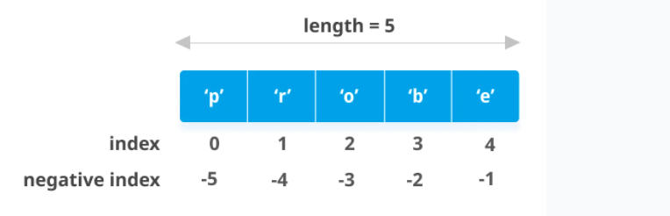
List - indexing

Slide 7
List - slicing
Items segmentation or slicing
When we slice lists, the start index is inclusive but the end index is exclusive0

Slide 8
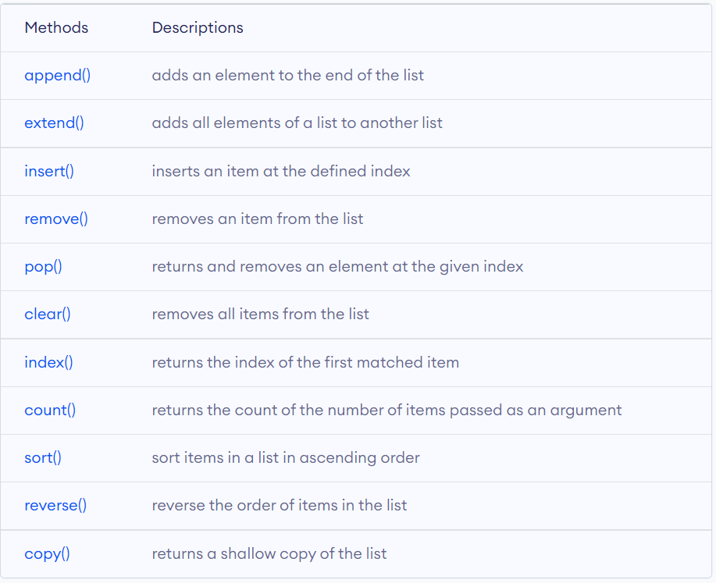
List - functions

Slide 9
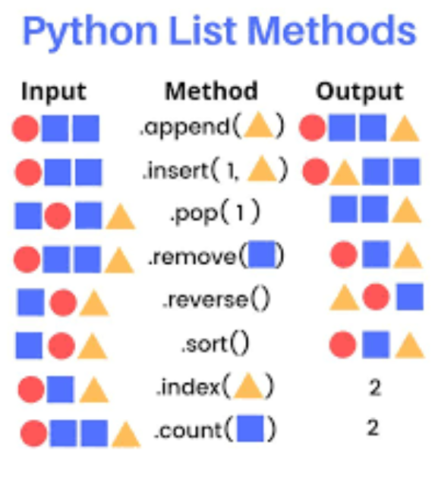
List – functions fun way

Slide 10
Tuple
Like LIST, tuple also have different type of data (including LIST, int, string, float), separated by comma but covered by ()
It can be used without () also – tuple packing
one element within parentheses is not enough but vice versa for without ()
Tuples – immutable – cannot be modified
Write protect data type – cannot change dynamically

Slide 11
Set
Mixed collection of data types, except list
{}
Unordered
Unique and immutable

Slide 12
Dictionary
Unordered collection
Key – value pair
Key –must for getting value

